Slide 1
Tensile Testing
Tensile test are performed for several reasons. The results of tensile tests are used in selecting materials for engineering applications. Tensile properties included in materials specifications to ensure quality.

Slide 2

Tensile specimen
Test specimens are prepared as per ASTM standards

Slide 3
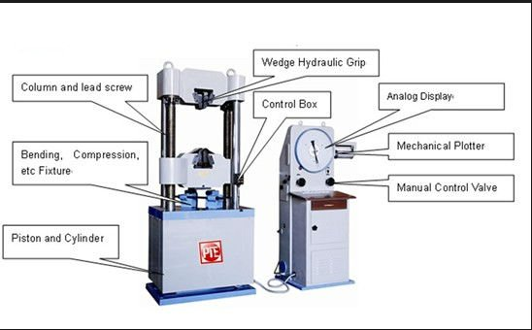
Tensile testing machine

Slide 4
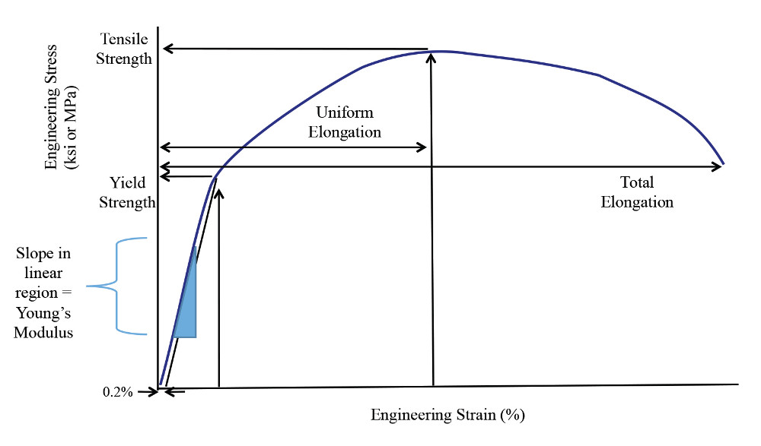

Stress – strain curves
b
c
a
o

Slide 5
Stress- strain curve (tensile test)
Stress
Strain
Yield point/Yield stress/yield strength
Proportional limit or Elastic limit
Ultimate tensile strength
Breaking stress
% of Ductility
% area of reduction
Modulus of elasticity or Young’s modulus (E)
Modulus of Resilience (Ur)
Toughness

Slide 6
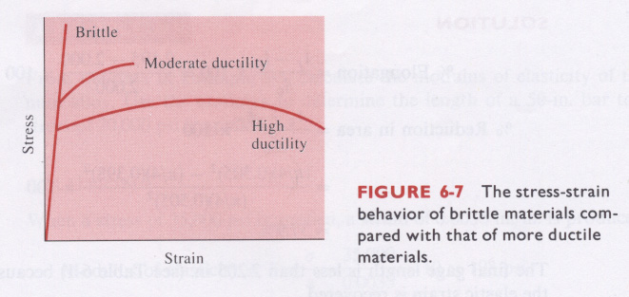

Slide 7
Elastic and Plastic Deformation
Elastic Deformation : The area of a stress - strain curve where the specimen will deform under load, yet return to its original shape when the load is removed.
In elastic deformation the change in shape of a materials is recoverable when the applied stress is removed.
Plastic Deformation: Deformation that occurs once the object has been stressed past its elastic limit. The deformation is no longer reversible.
In plastic deformation the change in shape of a materials is not recoverable when the applied stress is removed.

